Slide 1
Chapter 4: Normalization
Database CCS5001

Slide 2
Chapter Outline
First Normal Form (1NF)
Second Normal Form (2NF)
Third Normal Form (3NF)

Slide 3
Data Normalization
Primarily a tool to validate and improve a logical design so that it satisfies certain constraints that avoid unnecessary duplication of data
The process of decomposing relations with anomalies to produce smaller, well-structured relations

Slide 4
Recap…
Definition: A relation is a named, two-dimensional table of data
Table is made up of rows (records), and columns (attribute or field)
Not all tables qualify as relations
Requirements:
Every relation has a unique name.
Every attribute value is atomic (not multivalued, not composite)
Every row is unique (can’t have two rows with exactly the same values for all their fields)
Attributes (columns) in tables have unique names

Slide 5
Well-Structured Relations
A relation that contains minimal data redundancy and allows users to insert, delete, and update rows without causing data inconsistencies
Goal is to avoid anomalies
Insertion Anomaly – adding new rows forces user to include the details of that rows.
Deletion Anomaly – deleting rows may cause a loss of data that would be needed for other future rows
Modification Anomaly – changing data in a row forces changes to other rows because of duplication

Slide 6
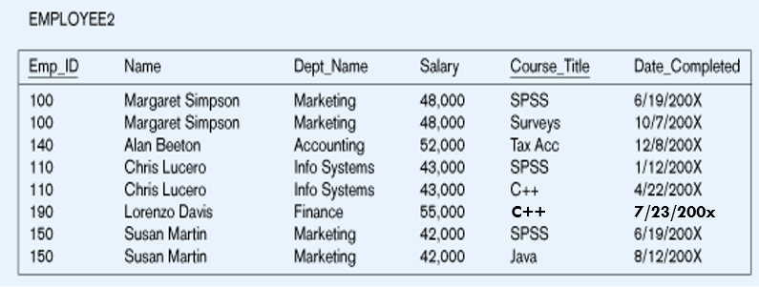
Figure 4.1 Employee table
Question – Is this a relation?
Answer – Yes: unique rows and no multivalued attributes
Question – What’s the primary key?
Answer – Composite: Emp_ID, Course_Title

Slide 7
Anomalies in this Table
Insertion – cannot enter a new employee without having the employee taking a course (since course_title is part of the primary key)
Deletion – if we remove employee 140, we lose information about the existence of a Tax Acc course
Modification – giving a salary increase to employees (eg. Emp_id 100) forces us to update multiple records
Why do these anomalies exist?
Because we’ve combined two themes (entity types) into one relation. This results in duplication, and an unnecessary dependency between the entities

Slide 8
Functional dependency
Functional dependency (FD) is a set of constraints between two attributes in a relation. Functional dependency says that if two tuples have same values for attributes A1, A2,..., An, then those two tuples must have to have same values for attributes B1, B2, ..., Bn.
Functional dependency is represented by an arrow sign (→) that is, X→Y, where X functionally determines Y. The left-hand side attributes determine the values of attributes on the right-hand side.
Candidate Key:
A unique identifier. One of the candidate keys will become the primary key
E.g. perhaps there is both credit card number and SS# in a table…in this case both are candidate keys
Each non-key field is functionally dependent on every candidate key
https://www.geeksforgeeks.org/introduction-of-database-normalization/

Slide 9
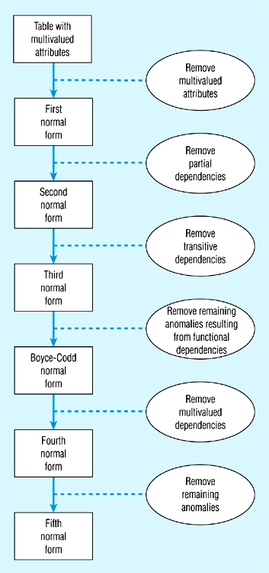
Figure 4.2 Steps in normalization
https://www.geeksforgeeks.org/normal-forms-in-dbms/

Slide 10

First Normal Form (1NF)
Disallows
composite attributes
multivalued attributes
nested relations; attributes whose values for an individual tuple are non-atomic
Considered to be part of the definition of a relation
Most RDBMSs allow only those relations to be defined that are in First Normal Form

Slide 11
First Normal Form (1NF)
(* not in 1NF-composite attribute)
Remove composite attribute -Projects
EMPLOYEE_PROJECT (1NF)
EMPLOYEE_PROJECT
 |  | Projects
SSN | EmpName | ProjecNumber | Hours
123 | Ahmad Ramli | 1 | 32.5
668 | Chan Sui Lin | 3 | 40
SSN | EmpName | ProjecNumber | Hours
123 | Ahmad Ramli | 1 | 32.5
668 | Chan Sui Lin | 3 | 40

Slide 12
First Normal Form (1NF)
(* not in 1NF - multi-valued attribute)
DEPARTMENT
DeptNumber | Dname | DeptMgr_SSN | DeptLocation
10 | Research | 789 | {Melaka, Sarawak, Terengganu}
20 | Administration | 562 | Selangor
30 | Headquarters | 891 | Kuala Lumpur
DEPARTMENT | (1NF)
DeptNumber | Dname | DeptMgr_SSN | DeptLocation
10 | Research | 789 | Melaka
10 | Research | 789 | Sarawak
10 | Research | 789 | Terengganu
20 | Administration | 562 | Selangor
30 | Headquarters | 891 | Kuala Lumpur
Insert new tuples for each value of the attribute

Slide 13
First Normal Form (1NF)
(* not in 1NF – nested relations with repeating groups)
EMPLOYEE_PROJECT
SSN | EmpName | ProjecNumber | Hours
123 | Ahmad Ramli | 1 | 32.5
 |  | 2 | 7.5
668 | Chan Sui Lin | 3 | 40
456 | Anita Ramasami | 1 | 20
 |  | 2 | 20
335 | Hanisah Bahrin | 2 | 10
 |  | 3 | 10
 |  | 10 | 10
nested relations: EMPLOYEE_PROJECT(SSN, EmpName(ProjectNumber, Hours))

Slide 14
First Normal Form (1NF)
For the nested relation with repeating groups, expand the table to become a relation with atomic values
EMPLOYEE_PROJECT
SSN | EmpName | ProjecNumber | Hours
123 | Ahmad Ramli | 1 | 32.5
123 | Ahmad Ramli | 2 | 7.5
668 | Chan Sui Lin | 3 | 40
456 | Anita Ramasami | 1 | 20
456 | Anita Ramasami | 2 | 20
335 | Hanisah Bahrin | 2 | 10
335 | Hanisah Bahrin | 3 | 10
335 | Hanisah Bahrin | 10 | 10
A relation with atomic values, but with repeating groups, therefore can be split further
As EMPLOYEE(SSN, EmpName) and EMPLOYEE_PROJECT(SSN, ProjectNumber, Hours)

Slide 15
First Normal Form (1NF)
EMPLOYEE
SSN | EmpName
123 | Ahmad Ramli
335 | Hanisah Bahrin
456 | Anita Ramasami
668 | Chan Sui Lin
EMPLOYEE_PROJECT
SSN | ProjecNumber | Hours
123 | 1 | 32.5
123 | 2 | 7.5
668 | 3 | 40
456 | 1 | 20
456 | 2 | 20
335 | 2 | 10
335 | 3 | 10
335 | 10 | 10

Slide 16
What is atomic value?
This mean that in your table, for every row-by-column position (cell), there exists only one value - not an array or list of values:
OrderID | CustID | Date | Items
1 | 4 | 4/11/02 | 5 Pencils, 3 Erasers, 6 Rulers
2 | 23 | 6/11/02 | 1 Scissor
3 | 15 | 7/11/02 | 2 Pen, 2 Notebook
4 | 2 | 7/11/02 | 15 5" Magazine File
5 | 23 | 7/11/02 | 1 Stapler
6 | 2 | 8/11/02 | 5 Kingston USB Flash Drive 8GB
Attribute ‘Items’ is not atomic

Slide 17
Example: Dept_Emp
DEPT_NO
MANAGER_NO
EMP_NO
EMP_NAME
D101
12345
20000 20001 20002
Carl Sagan Magic Johnson Larry Bird
D102
13456
30000 30001
Jimmy Carter Paul Simon
This table is NOT a RELATION, emp_no and emp_name are multi-valued, or because dept_no and manager_no makes repeating groups.

Slide 18
…and now, is this a relation?
Dept_No | Manager_No | Emp_No | Emp_Name
D101 | 12345 | 2000 | Carl Sagan
D101 | 12345 | 2001 | Magic Johnson
D101 | 12345 | 2002 | Larry Bird
D102 | 13456 | 3000 | Jimmy Carter
D102 | 13456 | 30001 | Paul Simon
By filling in all values, this Dept_Emp table is now a relation since there are no multi-valued attribute ie. only atomic values in each cell.
The PK is composite Dept_no, Emp_No.
For normalization until INF, if there are repeating groups then proceed with the next step. (in the next slide)

Slide 19
First Normal Form (1NF) - continue
If a relation has no repeating groups, it is said to be in first normal form (INF)
However this relation does contain repeating group:
DEPT_EMP(Dept_No, Manager_No, (Emp_No, Emp_Name))
Therefore, split them by creating separate relations
Everything that is not in the repeating group
ie. DEPT(Dept_No, Manager_No)
The repeating group attributes combine with the key attributes outside the group EMP(DeptNo, Emp_No, Emp_Name)

Slide 20
Second Normal Form (2NF)
1NF and no partial functional dependency
Uses the concepts of FDs, primary key
Definitions
Prime attribute: An attribute that is member of the primary key K
Non-prime attribute − An attribute, which is not a part of the prime-key, is said to be a non-prime attribute.
Full functional dependency : a FD Y-> Z where removal of any attribute from Y means the FD does not hold anymore

Slide 21
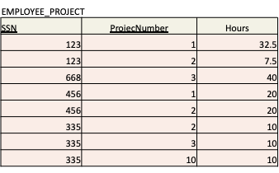
Second Normal Form (2NF)
The primary key (PK) is composite of SSN,ProjectNumber
Hours which is a non-prime attribute (non-key) is FULLY functionally dependent on the PK
Hours cannot be determined by only SSN
Hours cannot ne determined by only ProjectNumber
Therefore there is no PARTIAL functional dependencies

Slide 22
Second Normal Form (2NF)
A relation schema R is in second normal form(2NF) if every non-prime attribute A in R is fully functionally dependent on the primary key
R can be decomposed into 2NF relations via the process of 2NF normalization or “second normalization”
Fig. 4.1 is NOT in 2nd Normal Form (see fig 4.3)

Slide 23
Figure 4.3– Functional Dependencies in EMPLOYEE2
Dependency on entire primary key
EmpID
CourseTitle
Name
DeptName
Salary
DateCompleted
Dependency on only part of the key
EmpID, CourseTitle ➔ DateCompleted
EmpID ➔ Name, DeptName, Salary
Therefore, NOT in 2nd Normal Form!!

Slide 24
Getting it into 2nd Normal Form
Figure 4.4 – decomposed into two separate relations
Both are full functional dependencies
EmpID
Name
DeptName
Salary
EmpID
CourseTitle
DateCompleted

Slide 25
Third Normal Form
2NF PLUS no transitive dependencies (one attribute functionally determines a second, which functionally determines a third)
Definition:
Transitive functional dependency :a FD X-> Z that can be derived from two FDs X-> Y and Y->Z

Slide 26
Third Normal Form (3NF)
A relation schema R is in third normal form (3NF)if it is in 2NF and no non-prime attribute A in R is transitively dependent on the primary key
R can be decomposed into 3NF relations via the process of 3NF normalization
NOTE:
In X-> Y and Y-> Z, with X as the primary key, we consider this a problem only if Y is not a candidate key.
When Y is a candidate key, there is no problem with the transitive dependency
Fig. 4.5,4.6

Slide 27
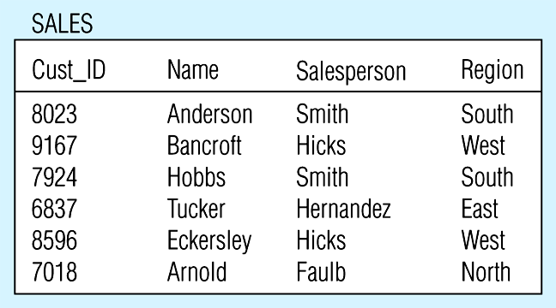
Figure 4.5-- Relation with transitive dependency
(a) SALES relation with simple data

Slide 28
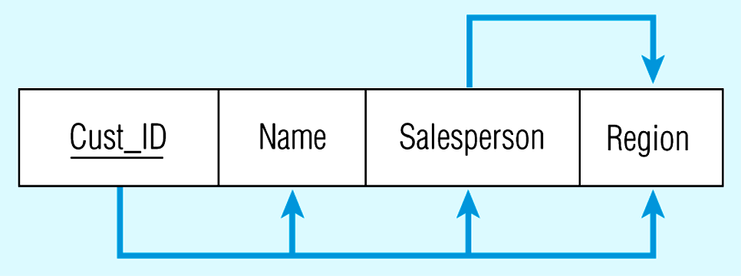
(b) Relation with transitive dependency
CustID → Name
CustID → Salesperson
CustID → Region
All this is OK
(2nd NF)
BUT, on assumption Salesperson is unique:
CustID → Salesperson → Region
Transitive dependency
(not 3rd NF)

Slide 29
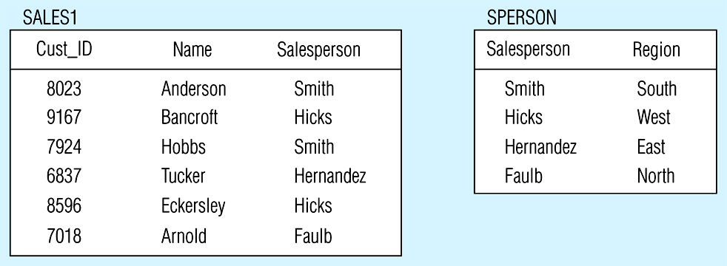
Figure 4.6 Removing a transitive dependency
(a) Decomposing the SALES relation
SPERSON(Salesperson, Region)
SALES1(Cust_ID, Name, Salesperson)

Slide 30
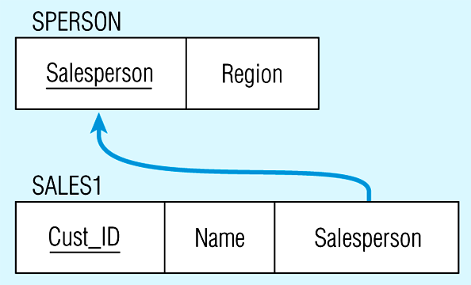
Figure 4.6(b) Relations in 3NF
Salesperson → Region
CustID → Name
CustID → Salesperson
Now, there are no transitive dependencies…
Both relations are in 3rd NF

Slide 31
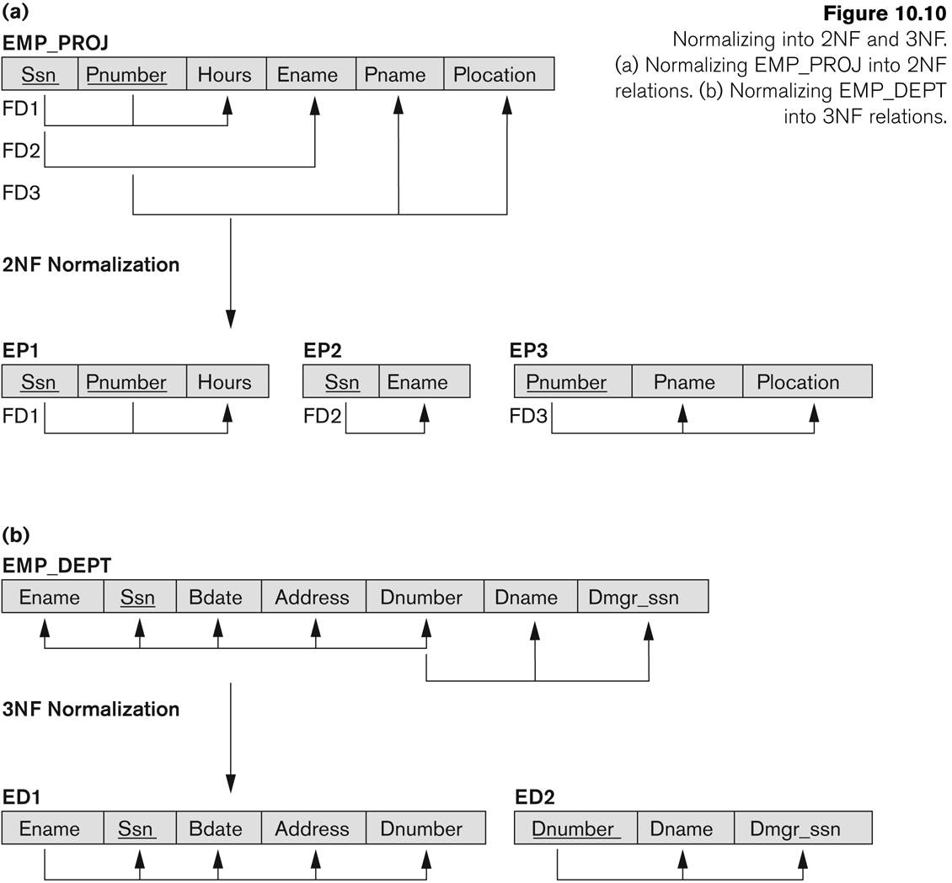
Normalization into 2NF and 3NF - example from Ramez Elmasri and Shamkant Navathe (2007)

Slide 32
Exercise: Perform Normalization until 3NF
DepartmentComplaint
Dept# | DeptName | Location | MgrName | MgrId | TelExt | Cust# | CustName | Dateof Complaint | Natureof Complaint
1123 | Soap Divison | Ipoh | Uwais | M45 | 6543 | C123 | Izzah | 24/4/09 | Not enough bubbles
 |  |  |  |  |  | C124 | Uzair | 14/6/09 | Smell like fish
# take a good look at the data and determine the primary key and other functional dependencies (FDs)
Dept#, Cust# → DeptName, Location,MgrName, MgrId, TelExt, CustName, DateOfComplaint,NatureOfComplaint
Dept# → DeptName, Location,MgrName, MgrId, TelExt
Cust# → CustName
MgrId → MgrName

Slide 33
Approaches to removing repeating groups
There are two approaches to removing repeating groups from unnormalized tables:
Removes the repeating groups by entering appropriate data in the empty columns of rows containing the repeating data.
Removes the repeating group by placing the repeating data, along with a copy of the original key attribute(s), in a separate relation. A primary key is identified for the new relation.

Slide 34
Split out repeating elements
DEPARTMENTCOMPLAINT
Dept# | DeptName | Location | MgrName | MgrId | TelExt | Cust# | CustName | Dateof Complaint | Natureof Complaint
1123 | Soap Divison | Ipoh | Uwais | M45 | 6543 | C123 | Izzah | 24/4/09 | Not enough bubbles
1123 | Soap Division | Ipoh | Uwais | M45 | 6543 | C124 | Uzair | 14/6/09 | Smell like fish
DEPARTMENT
Dept# | DeptName | Location | MgrName | MgrId | TelExt
1123 | Soap Divison | Ipoh | Uwais | M45 | 6543
COMPLAINT
Dept# | Cust# | CustName | Dateof Complaint | Natureof Complaint
1123 | C123 | Izzah | 24/4/09 | Not enough bubbles
1123 | C124 | Uzair | 14/6/09 | Smell like fish

Slide 35
2NF : Remove partial dependencies
DEPARTMENT
Dept# | DeptName | Location | MgrName | MgrId | TelExt
COMPLAINT
Dept# | Cust# | CustName | Dateof Complaint | Natureof Complaint
CUSTOMERCOMPLAINT
Dept# | Cust# | DateofComplaint | NatureofComplaint
CUSTOMER
Cust# | CustName
DEPARTMENT
Dept# | DeptName | Location | MgrName | MgrId | TelExt

Slide 36
3NF : Remove transitive dependencies
CUSTOMERCOMPLAINT
CUSTOMER
Dept# | Cust# | DateofComplaint | NatureofComplaint
Cust# | CustName
DEPARTMENT
Dept# | DeptName | Location | MgrName | MgrId | TelExt
MANAGER
CUSTOMER
MgrId | MgrName
Cust# | CustName
DEPARTMENT
Dept# | DeptName | Location | MgrId | TelExt
CUSTOMERCOMPLAINT
Dept# | Cust# | DateofComplaint | NatureofComplaint

Slide 37
In a nutshell
A table is in first normal form if
there are no repeating groups
all the key attributes are defined
all attributes are dependent on the primary key
A table is in 2nd normal form if
it's in 1st normal form
it includes no partial dependencies (where an attribute is dependent on only a part of a primary key).
A table is in 3rd normal form if
It's in 2nd normal form
It contains no transitive dependencies (where a non-key attribute is dependent on another non-key attribute).

Slide 38
Chapter Summary
Functional Dependencies (FDs)
Normal Forms (1NF, 2NF, 3NF) Based on PrimaryKeys
General Normal Form Definitions of 2NF and 3NF(For Multiple Keys)

Slide 39
Exercise 1
ClientNo | cName | propertyNo | pAddress | rentStart | rentFinish | rent | ownerNo | oName
CR76 | John kay | PG4 PG16 | 6 lawrence St,Glasgow 5 Novar Dr, Glasgow | 1-Jul-00 1-Sep-02 | 31-Aug-01 1-Sep-02 | 350 450 | CO40 CO93 | Tina Murphy Tony Shaw
CR56 | Aline Stewart | PG4 PG36 PG16 | 6 lawrence St,Glasgow 2 Manor Rd, Glasgow 5 Novar Dr, Glasgow | 1-Sep-99 10-Oct-00 1-Nov-02 | 10-Jun-00 1-Dec-01 1-Aug-03 | 350 370 450 | CO40 CO93 CO93 | Tina Murphy Tony Shaw Tony Shaw

Slide 40
Exercise 2
Student ID | Student Name | Major | Advisor | Advisor City
123 | Avi | Economics | Samuelson | Cambridge
123 | Avi | Math | Nash | New Haven
456 | Darin | Math | Nash | New Haven
789 | Len | Physics | Einstein | Princeton
999 | Richard | Physics | Bohr | Munich

Slide 41
Exercise 3
Fields in the original data table will be as follows:
SalesOrderNo, Date, CustomerNo, CustomerName, CustomerAdd, ClerkNo, ClerkName, ItemNo, Description, Qty, UnitPrice
Decompose the relation until to 3NF.

